Slide 1

EDA: Wine Presentation
Hayoung Cheon Jack Korbitz Samson Akomolafe

Slide 2
DATA VARIABLES
Numeric Variables
Fixed Acidity
Volatile Acidity
Citric Acid
Residual Sugar
Chlorides
Free Sulfur Dioxide(FSO2)
Total Sulfur Dioxide(TSO2)
Density
pH
Sulphates
Alcohol
Categorical Variables
Type
Location
Quality

Slide 3
EDA: Wine Presentation
Type

Slide 4
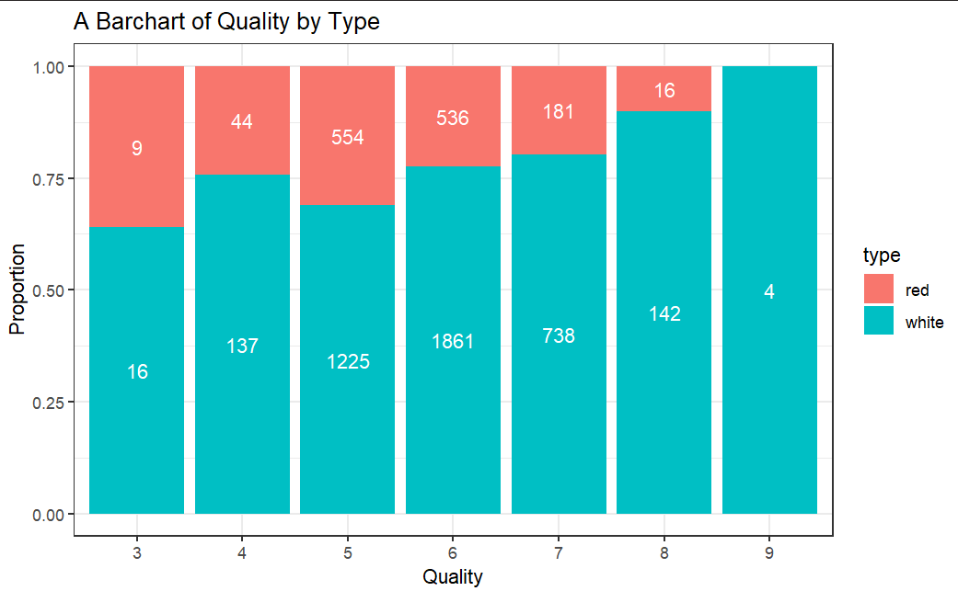
Type: Red vs Wine
White wine -> higher quality
There are sample sizes different to note.

Slide 5
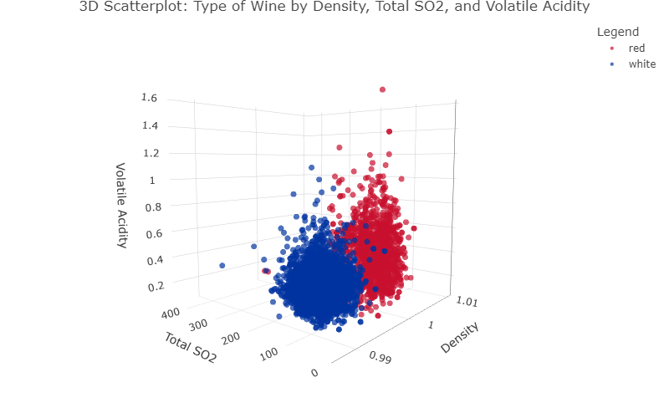
Type: Red vs Wine
Density: Red > White
Total SO2: Red < White
Volatile Acidity: Red > White
Note some Outliers!

Slide 6
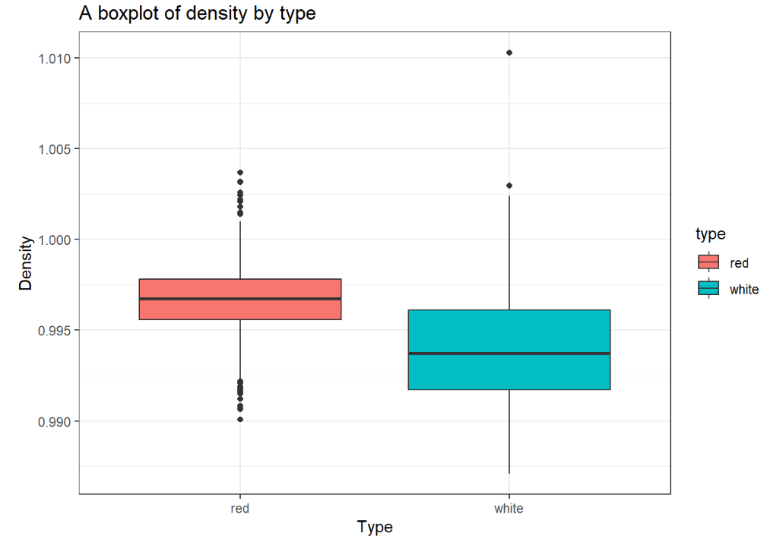
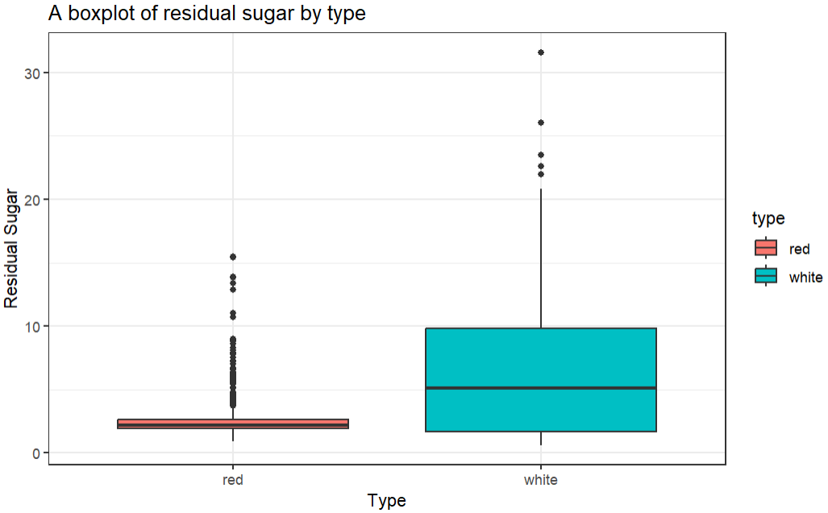
Type: Red vs Wine
Density : 1.0103
Residual Sugar: 31.6
Density -> more concentration, fuller body
Red wine are produced with grapes skins while white wine don’t include skins during production.
Unusual point : If it is a sweet wine, it can have high density with high residual sugar.
Notes:
Higher sugar easie spoileage

Slide 7
EDA: Wine Presentation
Location

Slide 8
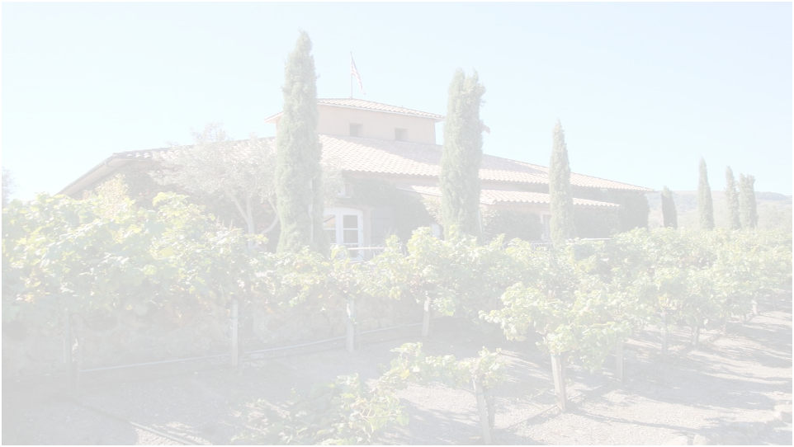
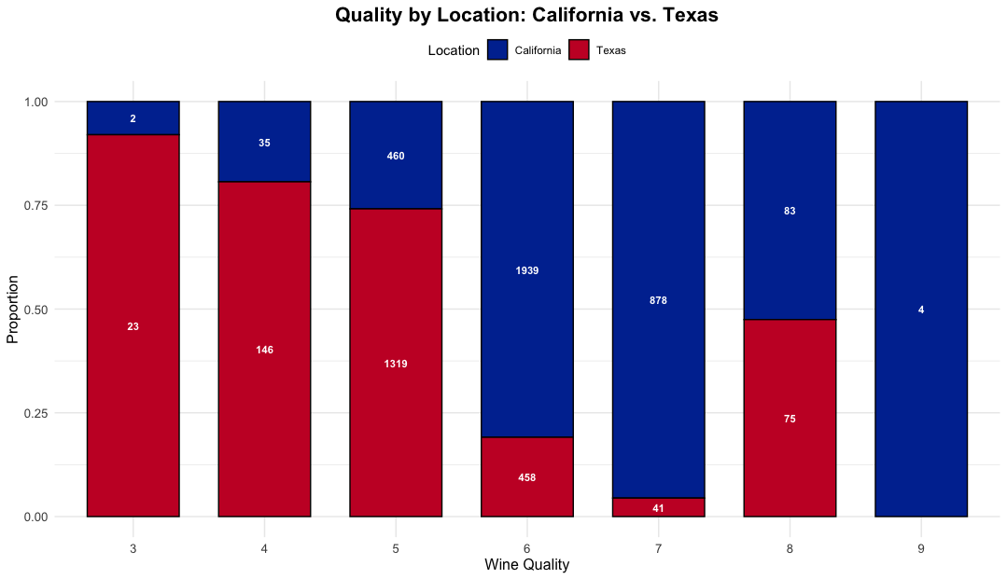
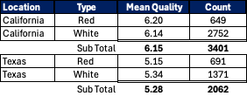
Location: Texas vs California
California Wine from this set is of higher quality
California is the largest US wine produce
California's Climate is more conducive to growing more types of wine
Limited to current Data set, different wine niches between states

Slide 9
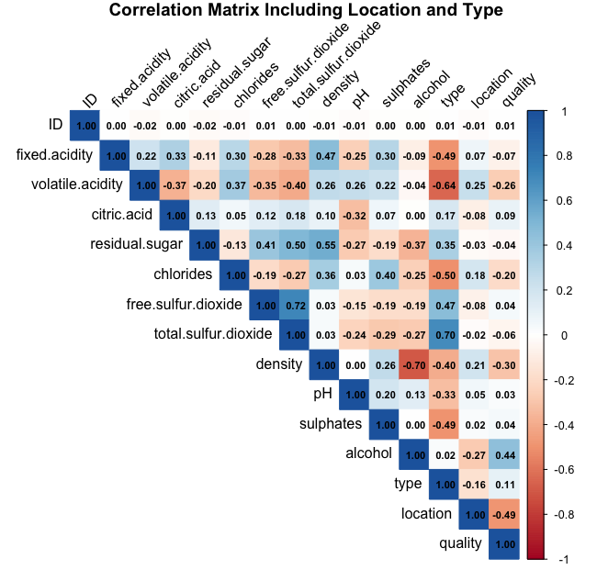
Location: Texas vs California
There is a moderate negative correlation between location and wine quality (-0.49)
Will not work when building a model to assess quality
Could skew the Test set
There is a small negative correlation (-0.27) between location and alcohol
There is also a small correlation (0.25) between location and volatile acidity
Without additional info, hard to differentiate compared to Type or quality

Slide 10
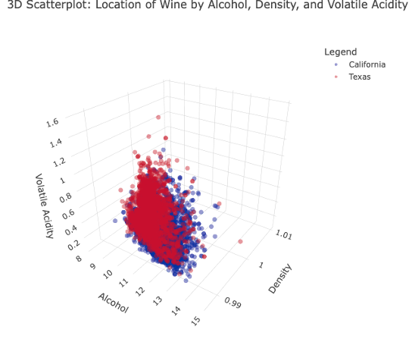
Location: Texas vs California
California Wines are
Lower Density
Higher Alcohol Content
Lower Volatile Acidity
In large part due to the distribution of having a higher percent of White Wine
Environmental Factors
Soil Composition
Climate (Dry)

Slide 11
EDA: Wine Presentation
Quality

Slide 12
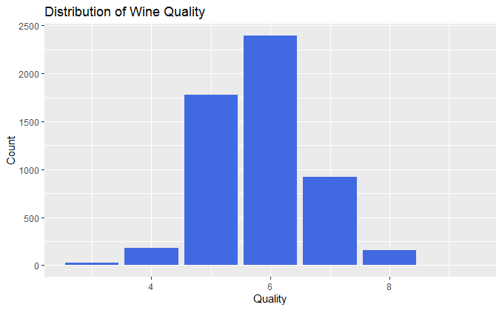

Quality Distribution of Wine Data
Observation
There are 6 calibrations of the wine quality (3,4,5,6,7,8, 9)
Calibration No 6 is the highest in the dataset under review. Which mean that the quality of wine in the data set in mostly just above average.
Calibration No 9 which is the highest of the quality value ranked 7th in the dataset. Most wines in the dataset did not meet the highest premium standard

Slide 13
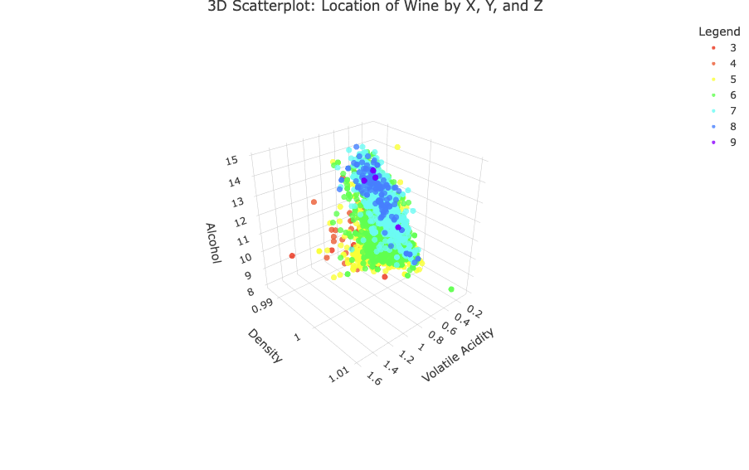
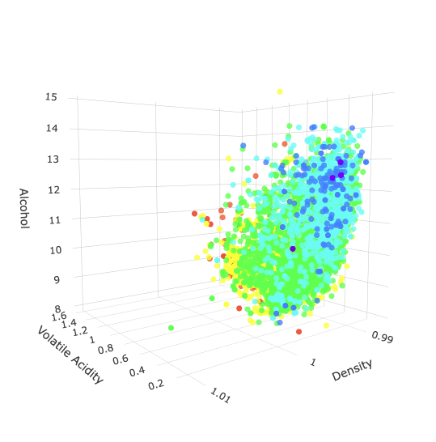
Quality Distribution of Wine by Alcohol, Density and Volatile Acidity

Slide 14
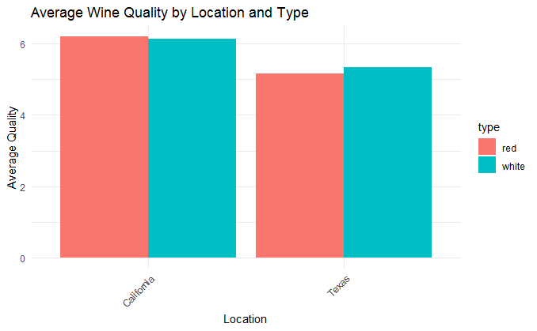
Showing Average Quality of Wine By Type and Location
Observation
As discovered above, most of the wines in the dataset had just above average quality.
The wine type quality did not show a very clear difference between California and Texas wines, Only that California produced or has more data for the wines produced.
Therefore, there are more red wines and white wines in California than what we saw in the dataset for Texas.

Slide 15
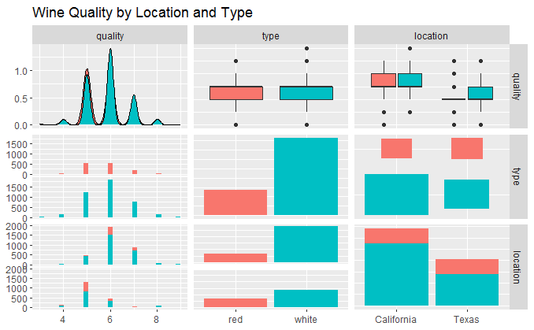
Pairplot Showing Relationship Between Quality, Location,Type
Observation
This is a diagrammatic representation by pairplot showing the impact of the 2 categorical variables (location and type) found in the dataset.

Slide 16
ANOVA TESTING FOR LOCATION AND TYPE
Df Sum Sq Mean Sq F value Pr(>F)
location 1 982.9 982.9 1707.656 < 2e-16 ***
type 1 3.2 3.2 5.583 0.0182 *
location:type 1 15.1 15.1 26.185 3.21e-07 ***
Residuals 5459 3142.0 0.6
---
Signif. codes: 0 ‘***’ 0.001 ‘**’ 0.01 ‘*’ 0.05 ‘.’ 0.1 ‘ ’ 1

Slide 17
Conclusion of the Analysis Quality by Location and Type
Summary of Interpretation
Location Effect: The results indicate a highly significant effect of location on wine quality (p < 0.001). This suggests that different locations produce wines of significantly different quality. But the dataset did not show what location. More in-depth work is required.
Type Effect: The effect of wine type on quality is also significant (p < 0.05), indicating that the type of wine does have an impact on its quality, although this effect is not as strong as the location effect. We could not clearly see which of the type of wine had more quality based on the dataset.
Interaction Effect: The interaction between location and type is highly significant (p < 0.001). This means that the effect of wine type on quality varies depending on the location, indicating complex relationships between these factors. As mentioned above, more wine data from California and Texas id required to do more in-depth work
Conclusion
In conclusion, both location and type significantly influence wine quality, and their interaction suggests that the effect of type is not consistent across different locations.
This information can be valuable for winemakers and consumers alike, as it highlights the importance of both geographical and varietal factors in determining wine quality.

Slide 18
Thank you!

